Slide 1
Software Engineering
Unit 14

Slide 2
Software Development Life Cycle (SDLC)
Process of developing a software system, encompassing activities from initial analysis phase through deployment, maintenance, and eventually, the demise of the system
Typical Phases:
Analysis
Design
Implementation
Integration
Operations/Maintenance

Slide 3
Analysis Phase
Determine what the program will do
Analyze the customer request for feasibility
Ask questions to clarify the request
Produce a requirements specification
Defines what the program will do once completed
Defines performance criteria

Slide 4
Design Phase
Plan how to implement the program
Identify underlying structures needed
Identify the major classes
Produces a description of the classes and methods
Defines the classes needed and their most important methods
Defines the relationships between the classes

Slide 5
Implementation Phase
Implement the planned classes and methods (write the code!)
Produces a completed program

Slide 6
Integration Phase
Verify that the program works according to the requirements spec
Unit tests – test an individual class
Integrated tests – test the interaction of multiple classes
Good test plan with thorough test data is crucial
Produces a report documenting the tests performed and the results of the tests

Slide 7
Operations/Maintenance Phase
Install the program at the customer site
Re-verify that the program still works
Train users
Program is now in everyday use
New bugs are discovered and fixed (maintenance)
New features are requested

Slide 8
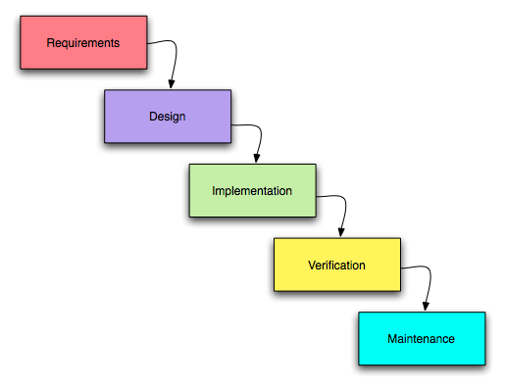
Waterfall Model

Slide 9
Waterfall Model
Model developed in the early 1970s for formal software development process
Fully complete each phase in sequence before moving to the next phase
Great in theory, tough in practice
Very difficult to achieve perfection in each stage with extremely large projects
Still widely used, but usually a modified form

Slide 10
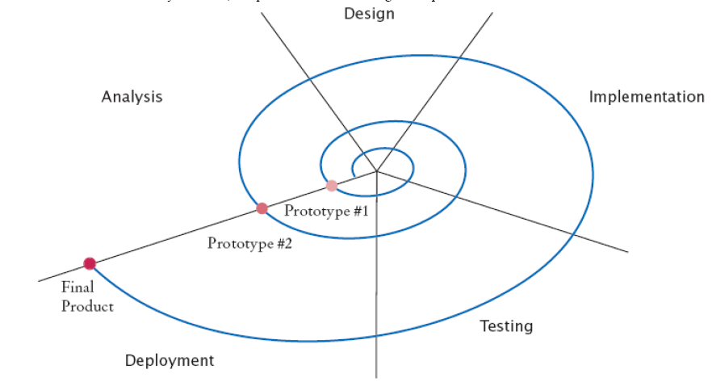
Spiral Model

Slide 11
Spiral Model
Defined by Barry Boehm in an article appearing in IEEE in May 1988
Combines an iterative variation of the waterfall model with prototyping in stages
In a short time span, work through SDLC to produce prototype
Go back through the SDLC and apply lessons learned, risk analysis, and customer feedback to produce another prototype or final program
Repeat until final program is produced
Better process, but time consuming

Slide 12
Other Models
New methodologies developed de-formalize the process and produce a higher quality product in a shorter time span
Rational Unified Process –
Phases overlap, especially implementation and testing
Predecessor to agile development
Extreme Programming
Cuts through formal, traditional processes
Focuses on best practices
Type of agile development

Slide 13
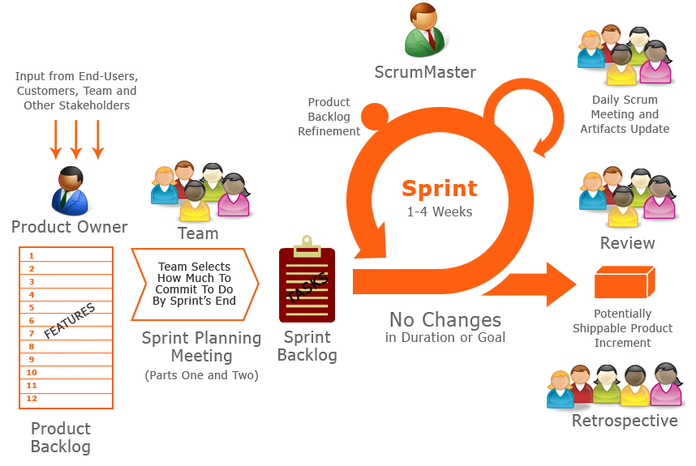
Agile Development

Slide 14
Agile Development
2001 – the Manifesto for Agile Development
Based on iterative, incremental development
Requirements and solutions evolve through collaboration
Responds quickly to changes

Slide 15
Object-Oriented Design
Find the classes
Determine each class’ responsibilities
Describe the relationships between classes

Slide 16
Find the Classes
Examine the problem description
Identify potential classes by looking for the significant nouns
Brainstorming is good!
You can always eliminate a class later
Separate potential classes from potential attributes
Define the behavior for each major class by looking for the significant verbs

Slide 17
Find the Classes
Remember:
Classes represents multiple objects that exhibit the same behavior (like players, customers, accounts)
Don’t overly complicate the design
A primitive type may be sufficient
A Java library may provide the necessary class
Additional classes may be discovered later

Slide 18
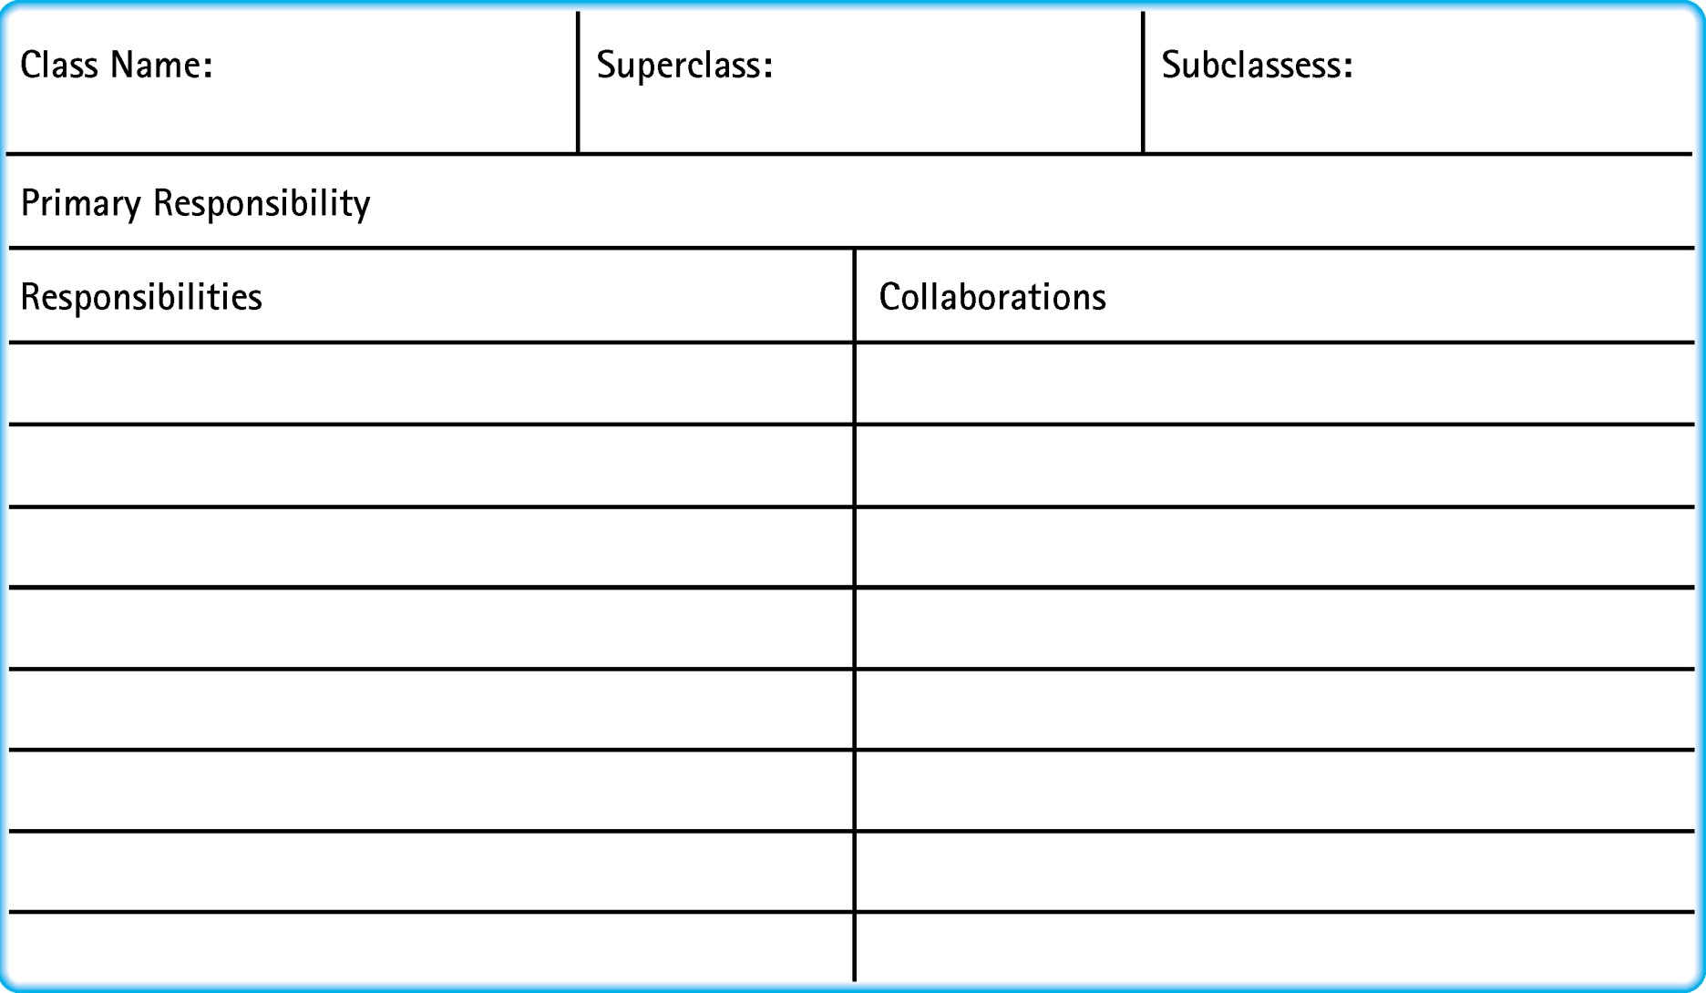
CRC Card

Slide 19
Determine Class Responsibilities
CRC Cards are used to discover each Class, its Responsibilities, and its Collaborators
Create an index card for each potential class
Identify tasks (methods) in the problem description
Determine which class is responsible for the task (write it on its card)
Determine any other classes needed to fulfill task (collaborators)

Slide 20
Describe Relationships Between Classes
Inheritance
Aggregation
Dependency

Slide 21
Inheritance
Models “is-a” relationship
A Rectangle2D is-a RectangleShape
A HashSet is-a Set
Useful when a group of objects exhibit the same behaviors
Use inheritance to group those objects that have some common attributes and implementations (superclass and subclasses)
Use interfaces to group those objects that have very different implementations (e.g., HashSet and TreeSet)

Slide 22
Aggregation (Composition)
Models “has-a” relationship
A Twitter has-a adjMatrix
A Twitter has-a Person collection
Objects in one class contain references to objects of another class

Slide 23
Dependency
Models “uses” relationship
Method of a class uses an object of another class (temporary)
Example: Scanner class, Math class
More of a utilitarian relationship
Weaker connection than aggregation
Use aggregation when information about an object needs to be remembered between method calls

Slide 24
Unified Modeling Language (UML)
Graphical scheme for representing analysis and design decisions
Classes are represented by rectangles
Relationship | Symbol | Line Style | Arrow Tip
Inheritance |  | Solid | Triangle
Interface Implementation |  | Dotted | Triangle
Aggregation |  | Solid | Diamond
Dependency |  | Dotted | Open

Slide 25
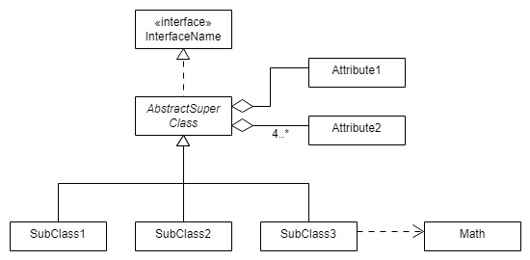
UML Example
Symbol | Meaning
* | Any number (zero or more)
1..* | One or more
0..1 | Zero or one
1 | Exactly one
Multiplicities:

Slide 26
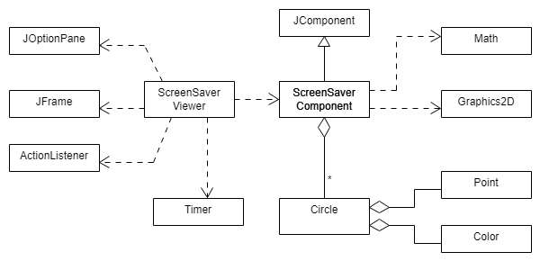
UML Example: ScreenSaver Lab

